Slide 1
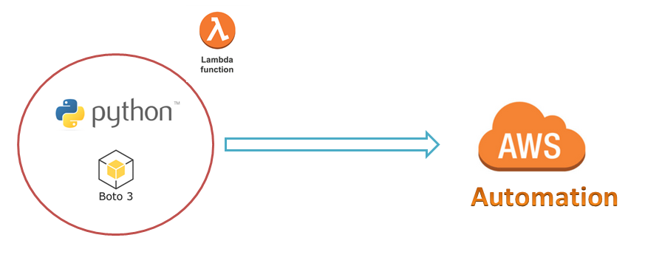
AWS Automation
with
boto3 of Python and Lambda Functions
Boto3 Environment Setup on Windows Server to Work with AWS Services
Loop control statements or commands
(break and continue)
Learn how to automate AWS common tasks using boto3 and Lambda

Slide 2

Boto3 Environment setup on Windows Server
You’ve got the Python-3.x and boto3.
But, you won’t be able to use it right now, because it doesn’t know which AWS account it should connect to.
Then how about programmatic access when we want to manage AWS Services using our popular python scripting language ?
You’ll need to provide/configure some valid credentials( programmatic access keys)
You can use either root or any IAM user programmatic access keys.
Lets get programmatic access keys
Loop control statements or commands
(break and continue)
Learn how to automate AWS common tasks using boto3 and Lambda

Slide 3
Boto3 Environment setup on Windows Server…
Configure credentials of your AWS account on windows server using awscli commands.
Install awscli
pip3 install awscli
Configure root/IAM user access-keys/credentials using:
aws configure --profile root
aws configure --profile non_prod
aws configure --profile prod
Loop control statements or commands
(break and continue)
Learn how to automate AWS common tasks using boto3 and Lambda

Slide 4
Thank you

